Slide 1
Need whiteboards and calculators
Spatial patterns.
Aim – Be able to:
Describe and draw spatial patterns
PBS focus:
Show respect for each other as we navigate our learning environment.
Plan:
Terminology
Making patterns
Describing patterns

Slide 2
Starter – exercise books!
2, 4, 6, 8, __, __,…
32, 28, 24,__, __....
1, 4, 9, 16, 25, __, __....
M, T, W, T, F, __, __...
1, 1, 2, 3, 5, 8, __, __...

Slide 3
Sequences
Key words:
Sequence –
Term –
Common Difference –
A list of numbers or shapes that follow some pattern
A number or shape in the sequence
The constant rate at which a sequence increases or decreases

Slide 4
Sequences
Key words:
Sequence –
Term –
Common Difference –

Slide 5
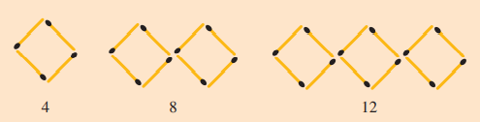
Spatial patterns
A spatial pattern is a sequence of geometrical shapes that can be described by a number pattern.

Slide 6

Spatial pattern
Draw the next term in the sequence.
Number of squares | 1 | 2 | 3 | 4 | 5 | 6
Number of matches | 4 | 7 | 10
How can we describe this sequence in words?

Slide 7
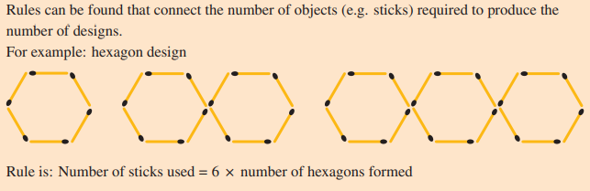
Rules
Number of hexagons | 1 | 2 | 3 | 4 | 5 | 6
Number of matches | 6 | 12 | 18

Slide 8
Whiteboards ready
Draw the next term in the sequence

Slide 9


Slide 11


Slide 12
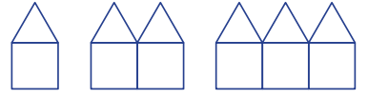

Slide 13
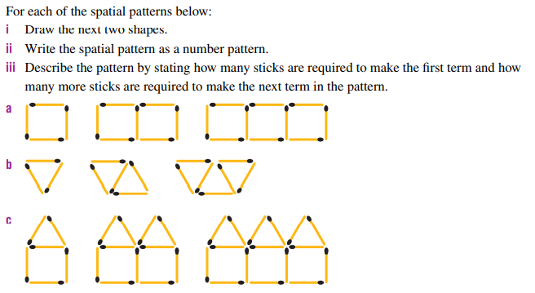

Slide 14
Bonus question:
For each pattern, how many sticks would be required for the 7th term?
a)
b)
c)

Slide 15
